Slide 1
Transposition
Transposition

Slide 2
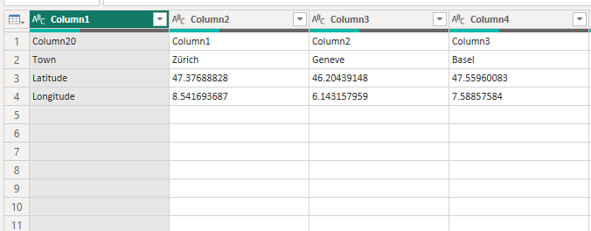
Transposition
Note: This Lab uses the DimStore.csv file located in the resources\Advanced Transformations folder
Edit the query in Power Query Editor
Observe the data structure carefully

Slide 3
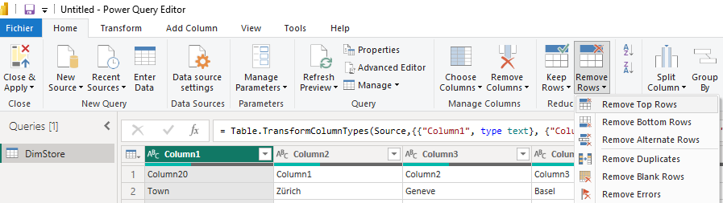
Transposition
Delete the first line
Note that at Column1 the values are Town , Latitude , Longitude
Select the Transform tab and click Transpose
Set first row as column headers

Slide 4
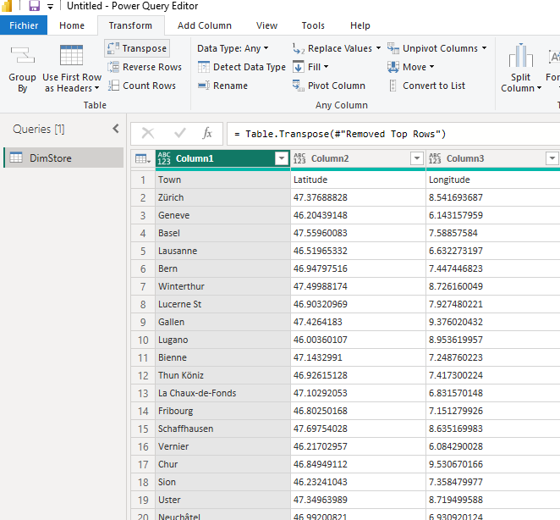
Transposition
Select the Transform tab and click Transpose

Slide 5
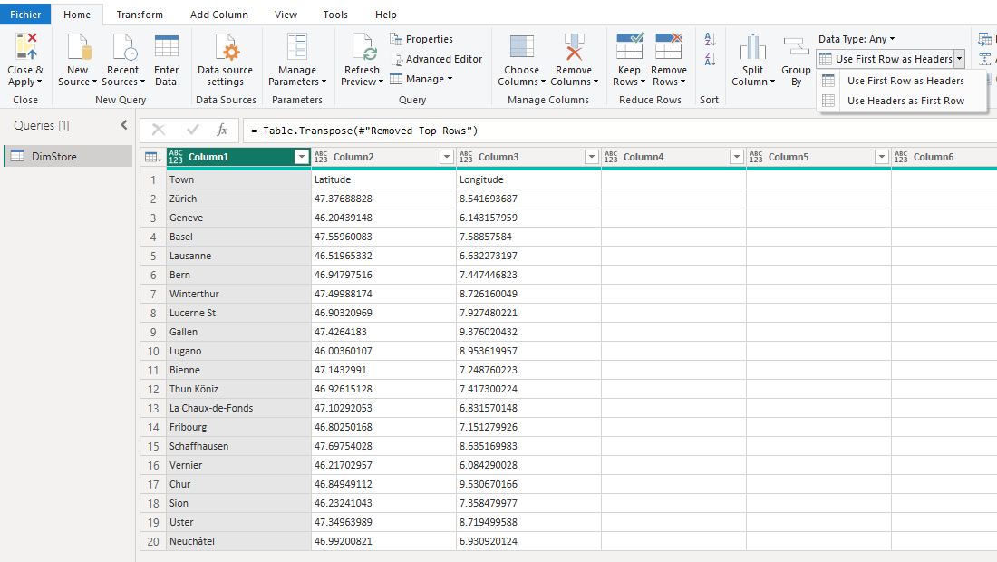
Transposition
Set first row as column headers

Slide 6
Thank you
Thank you

